Slide 1



HEALTH AND WELLNESS ASSISTANT
HIMA ATLURI – 1602-20-737-136
HRISHITHA – 1602-20-737-137

Slide 2






AGENDA
PROBLEM STATEMENT
ABSTRACT
METHODOLOGY
OUTPUT
FUTURE SCOPE

Slide 3
PROBLEM STATEMENT
The current landscape of digital health platforms lacks a comprehensive solution for both medical and mental health inquiries. Existing platforms often focus on one aspect, and traditional chatbots struggle to provide nuanced responses to mental health concerns. Our project addresses this gap by developing a website with two specialized chatbots—a retrieval-based chatbot for medical queries and a generative-based chatbot for mental health. The challenge lies in seamlessly integrating these technologies to offer accurate and timely responses, overcoming limitations in current systems. The goal is to create a user-friendly and inclusive healthcare platform that caters to both physical and mental well-being, providing personalized guidance and support.

Slide 4
ABSTRACT
Our forthcoming project involves the development of a dynamic and innovative website that incorporates two distinct types of chatbots—a retrieval-based chatbot tailored for medical inquiries and a generative-based chatbot focused on addressing mental health concerns. The retrieval-based chatbot is intricately designed to efficiently respond to users' medical queries by providing remedies and personalized doctor recommendations based on the symptoms they input. This approach ensures that users receive accurate and relevant information promptly, enhancing their overall healthcare experience.
In tandem, we are committed to integrating a generative-based chatbot dedicated to mental health support. This chatbot will go beyond traditional responses by analyzing user-provided responses to a comprehensive questionnaire. The generative model allows the chatbot to generate nuanced and personalized support and advice, catering to the unique challenges individuals face in the realm of mental health. This innovative dual-chatbot strategy aims to foster a holistic and inclusive platform, addressing both physical and mental well-being.

Slide 5
PROPOSED MODEL
HEALTH CARE
MENTAL HEALTH
RETRIEVAL BASED CHATBOT
GENERATIVE CHATBOT
SYMPTOM PREDICTION
REMEDY SUGGESTION
TABLET SUGGESTION
DOCTOR SUGGESTION
QUESTIONAIRE
SEVERITY PREDICTION
REMEDIES SUGGESTION
DOCTOR SUGGESTION

Slide 6
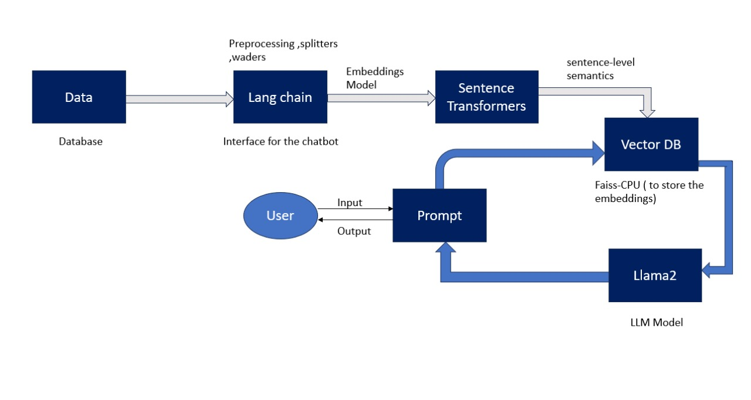
METHODOLOGY

Slide 7
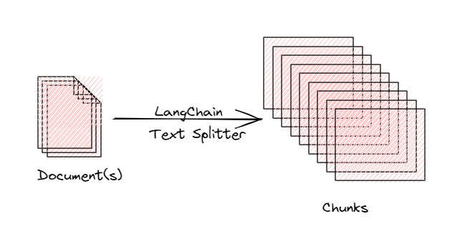
DOCUMENT/CSV TO SMALLER CHUNKS
Load the document using any document loaders
PyPDF, CSVLoader
The files are then split into smaller chunks
TextSplitter function
This is necessary because LLMs can only process a limited amount of text at a time.

Slide 8
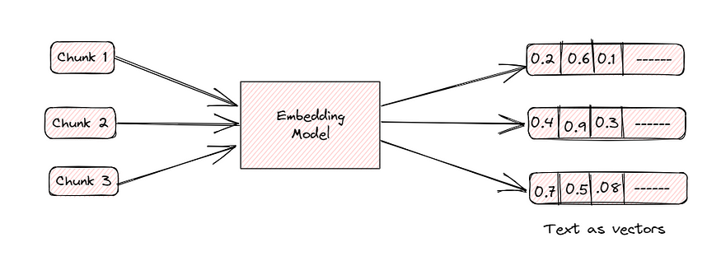
CHUNKS INTO EMBEDDINGS
Embeddings are numeric representations capturing the meaning of words, phrases, or sentences.
Sentence Transformer
Given an input text, it ouptuts a vector which captures the semantic information.
The sentence vector may be used for information retrieval, clustering or sentence similarity tasks.

Slide 9
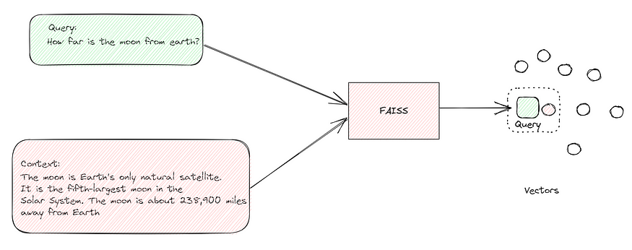
SIMILARITY SEARCH ON EMBEDDINGS
Use FAISS, an advanced tool, for efficient searches.
FAISS helps find embeddings (like key details) that closely match what you need.
Similarity search on embeddings locates closely related articles, paragraphs, or sentences.
The process transforms language and data into a measurable space.
Helps measure how similar different pieces of information are.
Enables sifting through information efficiently.
Delivers answers in line with the context of your questions.

Slide 10
GENERATE ANSWERS TO PROMPTS USING LLAMA2
After identifying the most similar chunks, the next step is generating an answer using LLAMA2.
To generate an answer, LangChain provides the question and the most similar chunks obtained from FAISS as input to the LLAMA2.
The Language Model utilizes the provided input to generate a relevant text response aligned with the original question.
LangChain employs the RetrievalQA chain to facilitate the entire process of question-answer generation.
This ensures a structured and effective approach to answering questions based on the identified similar chunks.

Slide 11
TECH STACK
Program language : Python
AI Framework : LangChain
Frontend : Chainlit
LLM : Llama2
Vector DB : FAISS

Slide 12
DATASET
https://www.kaggle.com/datasets/itachi9604/diseasesymptomdescriptiondataset?select=symptom_Description.csv
https://www.kaggle.com/datasets/joymarhew/medical-reccomadation-dataset
https://www.kaggle.com/code/mpwolke/medicine-recommendation/data
https://www.kaggle.com/datasets/kkhandekar/calories-in-food-items-per-100-grams?select=calories.csv
https://www.kaggle.com/datasets/uom190346a/food-ingredients-and-allergens

Slide 13
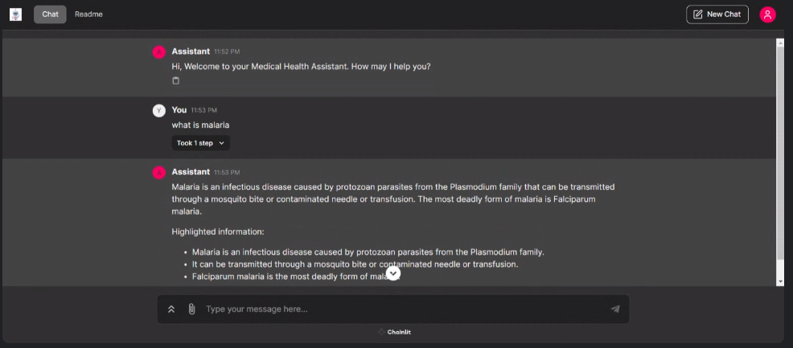
OUTPUTS

Slide 14
FOR THE NEXT REVIEW
Medical Imaging Analysis Integration:
Explore incorporating advanced algorithms for image recognition and interpretation.
Enhance the chatbot's diagnostic capabilities by analyzing medical imaging data such as X-rays and CT scans.
Mental Health Assistant using RAG

Slide 15
FUTURE SCOPE
Real-time Data Feeds from Wearables:
Integrate data from wearable devices and continuous monitoring tools. Leverage real-time data streams, including vital signs and activity levels, for personalized health insights.
Natural Language Processing with Voice Recognition:
Integrate voice and speech recognition technologies for spoken queries. Improve accessibility and user-friendliness by allowing users to interact with the chatbot through natural language.

Slide 16
THANK YOU

